Slide 1
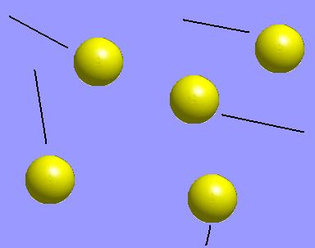
States of Matter
7.2.1.1
Notes:
Suggested sites:
http://www.chem4kids.com/files/matter_intro.html
http://www.usoe.k12.ut.us/CURR/SCIENCE/sciber00/8th/matter/sciber/intro.htm

Slide 2
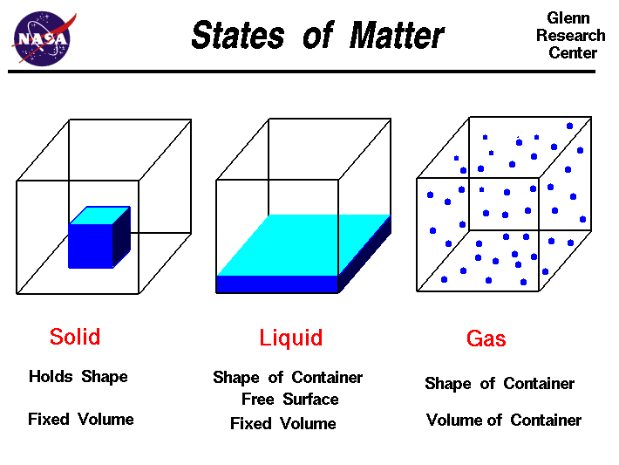

Slide 3
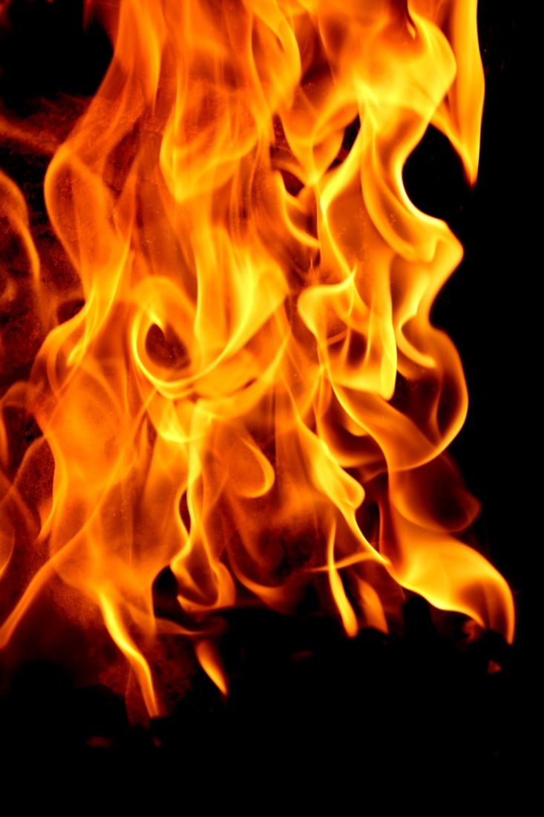

Gas

Slide 4
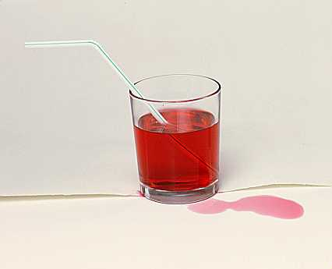

Liquid

Slide 5
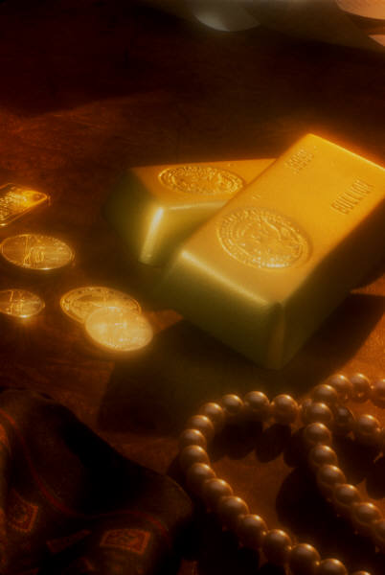

Solid

Slide 6
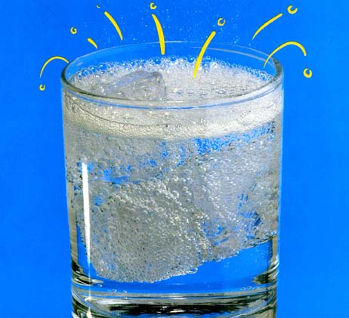
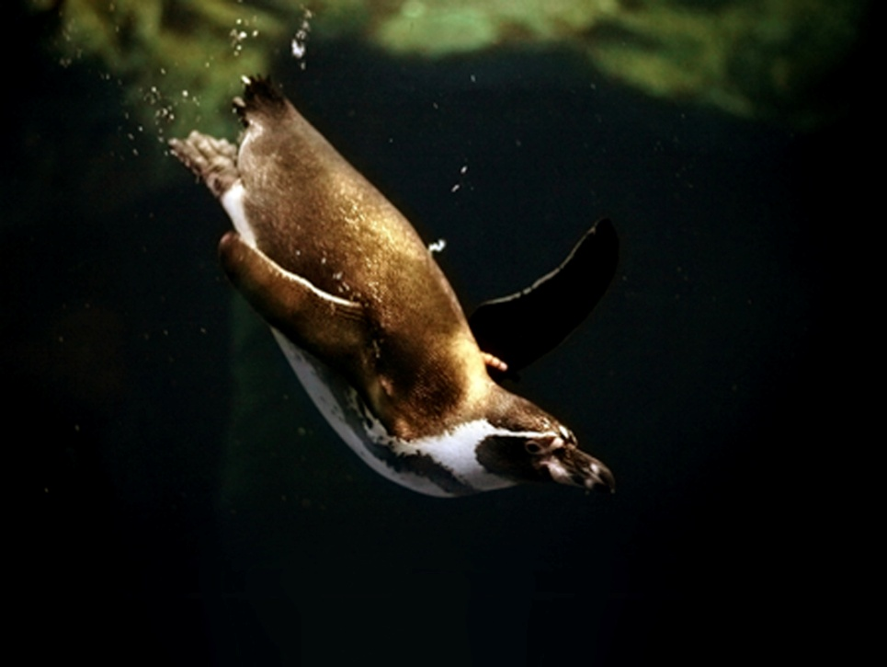
Can you find 3 states of matter in these pictures?
Click icon for song link ”Solid, Liquid, Gas”

Slide 7
Change of state is dependent on temperature
gas
evaporating
liquid
condensing
melting
freezing
solid
Increasing temperature

Slide 8
Interactive applet shows how temperature affects molecules http://www.colorado.edu/physics/2000/bec/temperature.html
gas
evaporating
liquid
condensing
melting
freezing
solid
Increasing temperature

Slide 9
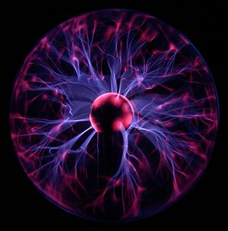
Plasma
Photo from:
http://upload.wikimedia.org/wikipedia/commons/thumb/2/26/Plasma-lamp_2.jpg/300px-Plasma-lamp_2.jpg

Slide 10
Solid—strong bonds
Liquid—weak bonds
Gas—no bonds
Plasma—ionization

Slide 11

Rachel Loersch
rloersch@smokyhill.org
(785) 825-9185

